Slide 1
Application and Data Integration
SE495: Software and Systems Integration

Slide 2
Outline
Introduction
What is Data Integration?
Data Integration Advantages
What is Application Integration?
Application Integration Advantages
Data Integration vs Application Integration
Use Cases
Tools

Slide 3
Introduction
Making sure your technology stack works for you requires integration on a fundamental level.
Everyone in your organization, from content writers who embed tweets into blog articles to data teams who reconcile data warehouses following a merger, can perform their duties more successfully with the help of coordinated data.
Choosing the best tool for the job requires a thorough understanding of each type of integration.

Slide 4
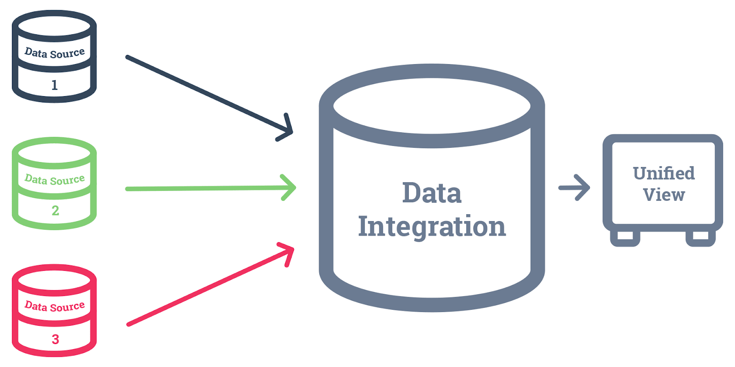
What is Data Integration?

Slide 5
What is Data Integration?
Data integration is the process of taking data from different sources and formats and combining it into a single data set.
The process of merging data from several sources and formats into a single data set is known as data integration.
Data integration involves more than just transferring data from one database to another; it also involves improving the usability of the data.
Data integration combines structured and unstructured data from various sources to produce new, useful data sets.
As a result, your analytics capabilities are improved, allowing you to comprehend business processes and spot fresh prospects for innovation.

Slide 6
What is Data Integration?
The most fundamental purpose of data integration is to input data into an application from one source and change it into a format that another program understands.
However, the demands of contemporary data integration have expanded the capabilities of extract, transform, and load (ETL).
Businesses today can eliminate data silos and maximize their use of data by integrating data in batch and real-time and employing automation to deal with problems.

Slide 7
Data Integration Advantages
Increasing data accessibility
Data integration can combine data from multiple locations and multiple sources into a unified view. Having these comprehensive insights helps companies improve collaboration and innovation.
Gaining more knowledge
Having a unified view of your data will give you better intelligence on your operations and customers. This, in turn, helps make more informed decisions and improve your processes.
Improving the integrity of the data
Your data quality is the true measure of its value. When data is incomplete or contains errors, it can hinder your ability to use it. Data integration tools can identify low-quality data.

Slide 8
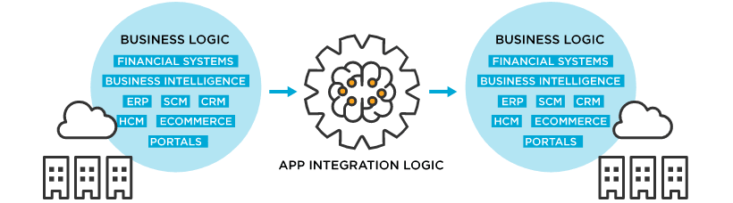
What is Application Integration?
An application integration creates connectors between two or more applications so they can work with one another.
By unifying the apps’ workflows and merging the data in real time, the integration eliminates data silos and increases efficiency throughout the organization.

Slide 9
What is Application Integration?
When two or more apps are integrated, connections are built between them so they can communicate with one another.
The connection breaks down data silos and boosts productivity across the entire organization by integrating the apps’ operations and merging the data in real-time.
For quicker and more effective lead follow-up, a business might combine an instant messaging platform like Slack with Salesforce.
Users can exchange information between the two without any hassle, thanks to application integration in this case.
To enable employees to use more modern tools and technologies with legacy systems, businesses can connect cloud-based and SaaS applications to on-premises and legacy systems using application integration.

Slide 10
Application Integration Advantages
Time-saving
Integrating the data from two or more applications can reduce the tedious work of transporting data back and forth manually.
Increasing functionality
Combining the capabilities of multiple applications, such as a banking app with a bookkeeping app, makes work more efficient, increases productivity and adds value to the user.
Promoting information sharing
Connecting applications throughout the organization eliminates silos that prevent various teams and departments from sharing ideas.
Application integration helps foster a culture of collaboration.

Slide 11
Data Integration vs Application Integration
Data Integration | Application Integration
– Data integration only allows one direction of data flow: from sources to a data warehouse or data lake, which serves as an analytics repository. Unlike application integration, data integration doesn’t need to be familiar with business processes; all it needs are data sources and a destination. – Data management and data orchestration for the business are the main focuses of data integration. This is handled by DataOps. – The schemas are dynamic. Hence, there is no need for pre-load transformations. Organizations prefer to store raw data and transform it depending on the use. However, some organizations use data pipelines to prepare the data before storing it. | – Data can be sent between various OLTP (online transaction processing) applications, one at a time, using application integration software. One process might use a specific application as a source, while another might use it as a destination. To properly integrate applications, you need to understand business or application logic. To do this, you must be aware of all the ways your company uses data. – Application data integration connects apps to create effective workflows using pre-existing integration platforms or new integrations using DevOps. – Applications use data that have fixed schemas. Hence, the data being pulled from one application must be transformed before it can be used by the second. This happens in a data pipeline so the data that is stored in either application is not affected.

Slide 12
Use Cases
Use Cases for Data Integration:
Transfer information to a data warehouse/lake.
Combine and compile client information from several sources into a single view.
Help a user make the switch to a multi cloud or hybrid cloud environment.
Use Cases for Application Integration:
To collect data from Internet of Things (IoT) devices so that it can be stored and used for analytics.
Sync legacy, on-premises ERP systems to CRMs.
Create automation between programs to create workflows that are more effective.

Slide 13
When to Use Which?
Application integration involves integrating two or more independent applications so that they can work together and exchange data.
This can be done through various methods such as APIs, message queues, or integration platforms.
Application integration is often used to automate business processes and improve efficiency by allowing different applications to share and process data.
Data integration involves integrating data from different sources and combining it into a single view or system.
This can be done through various methods such as ETL (extract, transform, load) processes, data lakes, or data warehouses.
Data integration is often used to support data analytics, reporting, and business intelligence by providing a single source of truth for data.

Slide 14
When to Use Which?
In general, application integration is used to integrate different applications and automate processes, while data integration is used to integrate and manage data from different sources.
Both types of integration can be used together to support various business needs

Slide 15
Combination of Application and Data Integration?
Digital transformation refers to the use of technology to fundamentally change how an organization operates and delivers value to its customers.
Data integration and application integration are often critical components of digital transformation initiatives because they enable the flow of data and the integration of systems and applications that are needed to support new digital processes and services.
The overlap between data integration and application integration in digital transformation initiatives is that they both involve the integration of various technologies and systems to support new digital processes and services.
By enabling the flow of data and integrating systems and applications, organizations can gain a more complete and unified view of their operations, which is necessary for effective digital transformation.

Slide 16
Data Integration Tools
Zapier
data integration and automation software that allows users to integrate web applications (thereby, data), automate workflows, and get more works done.
If This Then That (or IFTTT)
free, web-based application that enables users to create automation chains between other applications and web services
Automate.io
data integration software that integrates cloud applications and services, without any coding and using a drag-and-drop interface.
Talend Open Studio for Data Integration
open source, free data integration software that lets users easily aggregate, map, sort data in a user-friendly interface.

Slide 17
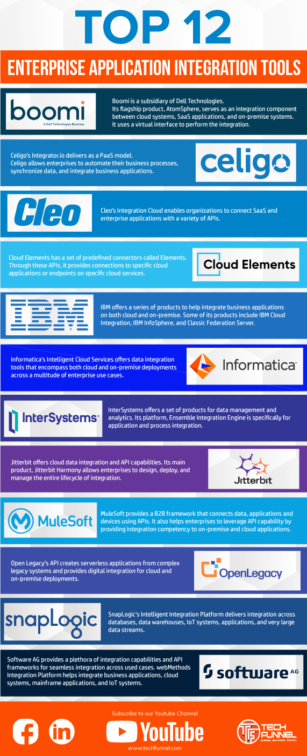
Application Integration Tools

Slide 18
Summary
Application integration links real-time data from several sources, whereas data integration combines various data sources into a single repository.
Whether it be user-friendliness and adaptability or thorough data management, each process has a unique set of advantages.
In Data Integration vs Application Integration, it doesn’t matter which is “better”.
Each of them is suitable for a unique purpose.
Data integration operates at the database level, whereas application integration deals with data at the application level.
So, the choice between Data Integration vs Application Integration will be based on your business’s unique requirements.
You can evaluate these requirements before you make the final call.

